Slide 1


THE MYSTERIES OF THE
DEEP LEARNING FOR SINGLE IMAGE SUPER RESOLUTION USING SATELLITE IMAGES
SUBMITTED BY: TANISHA JAIN
REGISTRATION NUMBER: 2427030775
COURSE: PBL-2
DEPARTMENT: COMPUTER SCIENCE ENGINEERING
GUIDE: MS NEHA
SATELLITE IMAGING

Slide 2
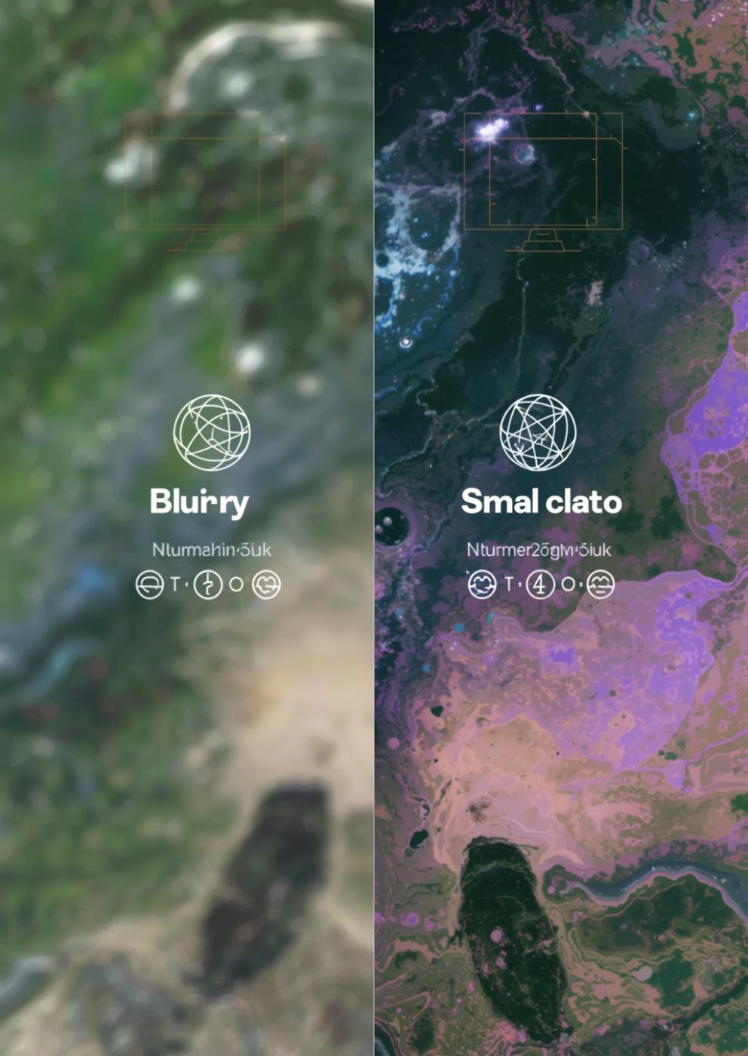

Enhancing Satellite Imagery
Satellite images are widely used in applications such as agriculture monitoring, disaster management, and urban planning. However, these images often suffer from low resolution due to sensor limitations and environmental factors.
This project aims to improve the quality of low resolution satellite images using deep learning based Single Image Super Resolution techniques. The system converts low resolution images into high resolution images while preserving image details.

Slide 3
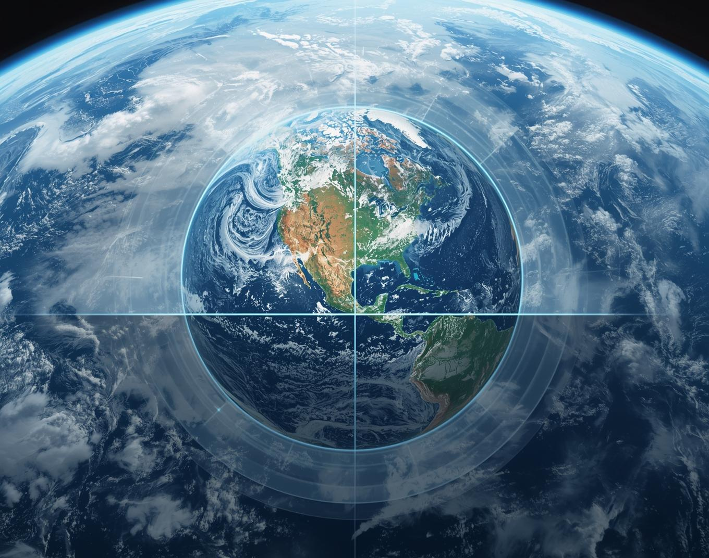
Challenges in Satellite Imaging
Satellite images captured from remote sensing devices often have low resolution due to hardware limitations, noise, and atmospheric disturbances.
Low resolution images lack important visual details and reduce accuracy in applications such as object detection and land analysis.
Therefore, there is a need for techniques that can enhance satellite image resolution and improve image quality.

Slide 4

LITERATURE OVERVIEW
Several deep learning approaches have been proposed for satellite image super resolution.
SRCNN (Super Resolution Convolutional Neural Network) is one of the earliest deep learning models that uses convolution layers to enhance image resolution. However, it produces blurry images and cannot recover fine textures.
SRGAN (Super Resolution Generative Adversarial Network) uses generator and discriminator networks to produce realistic high resolution images. However, training is unstable and may generate fake details.
ESRGAN (Enhanced Super Resolution GAN) improves SRGAN by using residual blocks and perceptual loss. It produces sharper images but requires high computational power.
Diffusion based models generate very high quality images but require large computational resources and slow training.
Recent satellite specific models use GAN based architectures to improve satellite image resolution but still struggle with reconstructing small objects and maintaining accurate structures.

Slide 5
Methodological Issues
Research Challenges & Limitations
Current research often suffers from inconsistent methodologies, leading to difficulties in replicating studies and validating results.Existing super resolution methods mainly focus on natural images and do not specifically address satellite image challenges.
Current models cannot recover very small objects and sometimes generate unrealistic structures. These methods require large computational resources and do not generalize well across different satellite datasets.
There is a need to develop efficient and accurate deep learning models specifically designed for satellite image enhancement.
INNOVATION
The innovation of this project is the application of deep learning based super resolution techniques specifically for satellite images.
Unlike traditional approaches designed for natural images, this work focuses on satellite image characteristics such as noise and structural complexity.
The project aims to improve image clarity and reconstruction quality while addressing limitations of existing models.

Slide 6
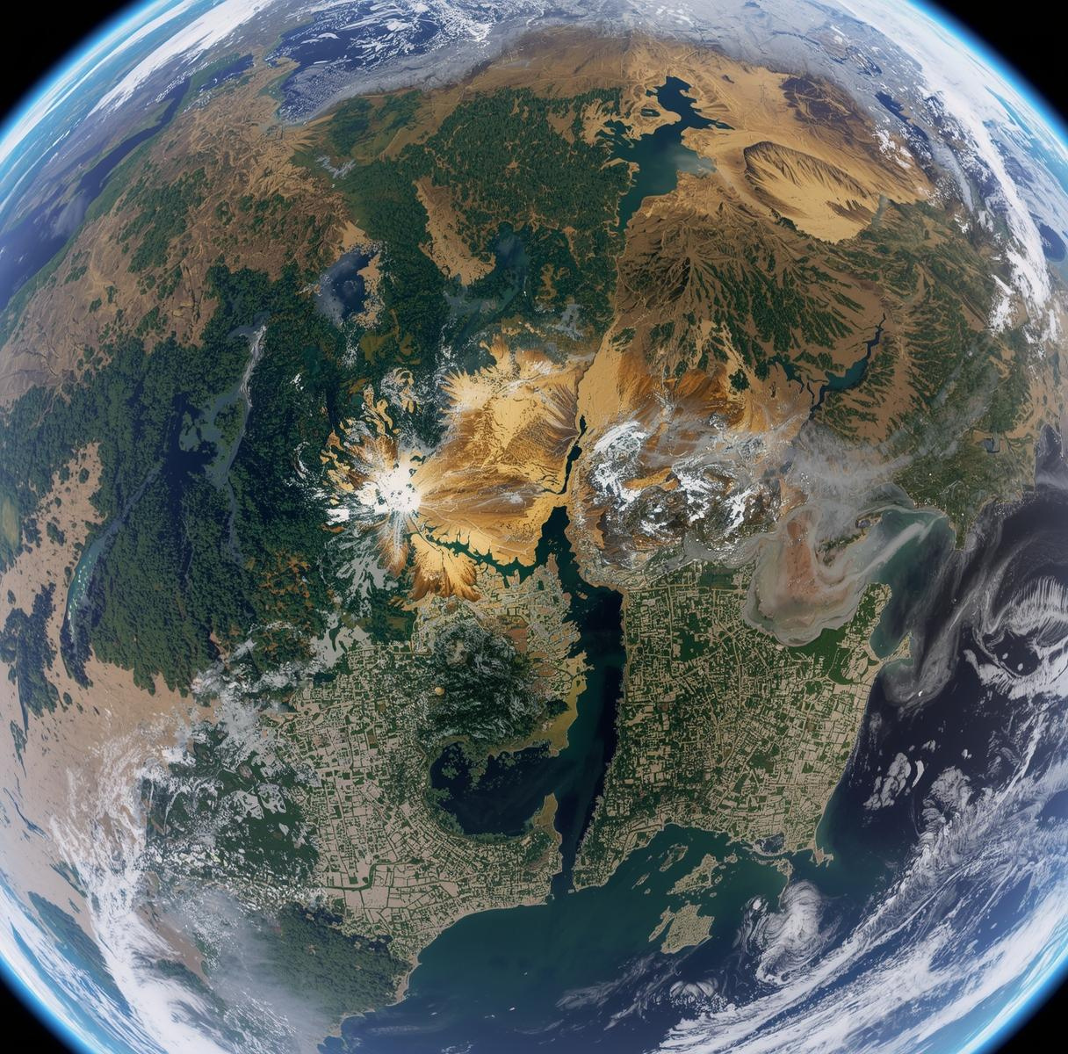
Satellite Image Datasets
The dataset used in this project is the 4× Satellite Image Super Resolution dataset obtained from Kaggle. It contains paired low resolution and high resolution satellite images used for training and testing the super resolution model. The dataset helps the model learn mapping between low quality and high quality images.

Slide 7
METHODOLOGY
The proposed system uses a deep learning based approach to improve the resolution of satellite images using Single Image Super Resolution techniques.
The system takes a low resolution satellite image as input and generates a high resolution image with improved quality and details. The methodology consists of the following steps.
Step 1: Dataset Collection
Satellite image dataset is collected from Kaggle containing paired low resolution and high resolution images. These images are used for training and testing the model.
Step 2: Data Preprocessing
The satellite images are resized and normalized to prepare them for model training. Image pairs are organized into input (low resolution) and target (high resolution) images.
Step 3: Model Training using ESRGAN
The Enhanced Super Resolution Generative Adversarial Network (ESRGAN) model is used to learn mapping between low resolution and high resolution images. The generator network enhances image resolution while the discriminator evaluates image quality.
Step 4: Image Reconstruction
The trained model converts low resolution satellite images into high resolution images by reconstructing missing details and improving image clarity.
Step 5: Performance Evaluation
The output images are evaluated using image quality metrics such as PSNR and SSIM to measure improvement in resolution and structural similarity.
Step 6: Result Analysis
The enhanced images are compared with original low resolution images to analyze improvement in visual quality and detail preservation.

Slide 8







Project Timeline Path
Five sequential phases mark project progress milestones
Phase 1
Phase 2
Phase 3
Phase 4
Phase 5
LOW RESOLUTION
SATELLITE IMAGE
DATASET COLLECTION AND
IMAGE PREPROCESSING
ESRGAN MODEL TRAINING AND
HIGH RESOLUTION IMAGE GENERATION
PERFORMACE EVALUATION
RESULT ANALYSIS

Slide 9


Expected Results Overview
The proposed system is expected to improve the spatial resolution of low resolution satellite images using deep learning based super resolution techniques.
The model will generate high resolution satellite images from low resolution inputs by reconstructing missing details and enhancing image clarity. The output images are expected to show improved texture, sharper edges, and better structural information compared to the original images. The enhanced satellite images can improve accuracy in applications such as land monitoring, environmental analysis, and object detection. The system is expected to provide better visual interpretation and improved decision making using satellite data.

Slide 10
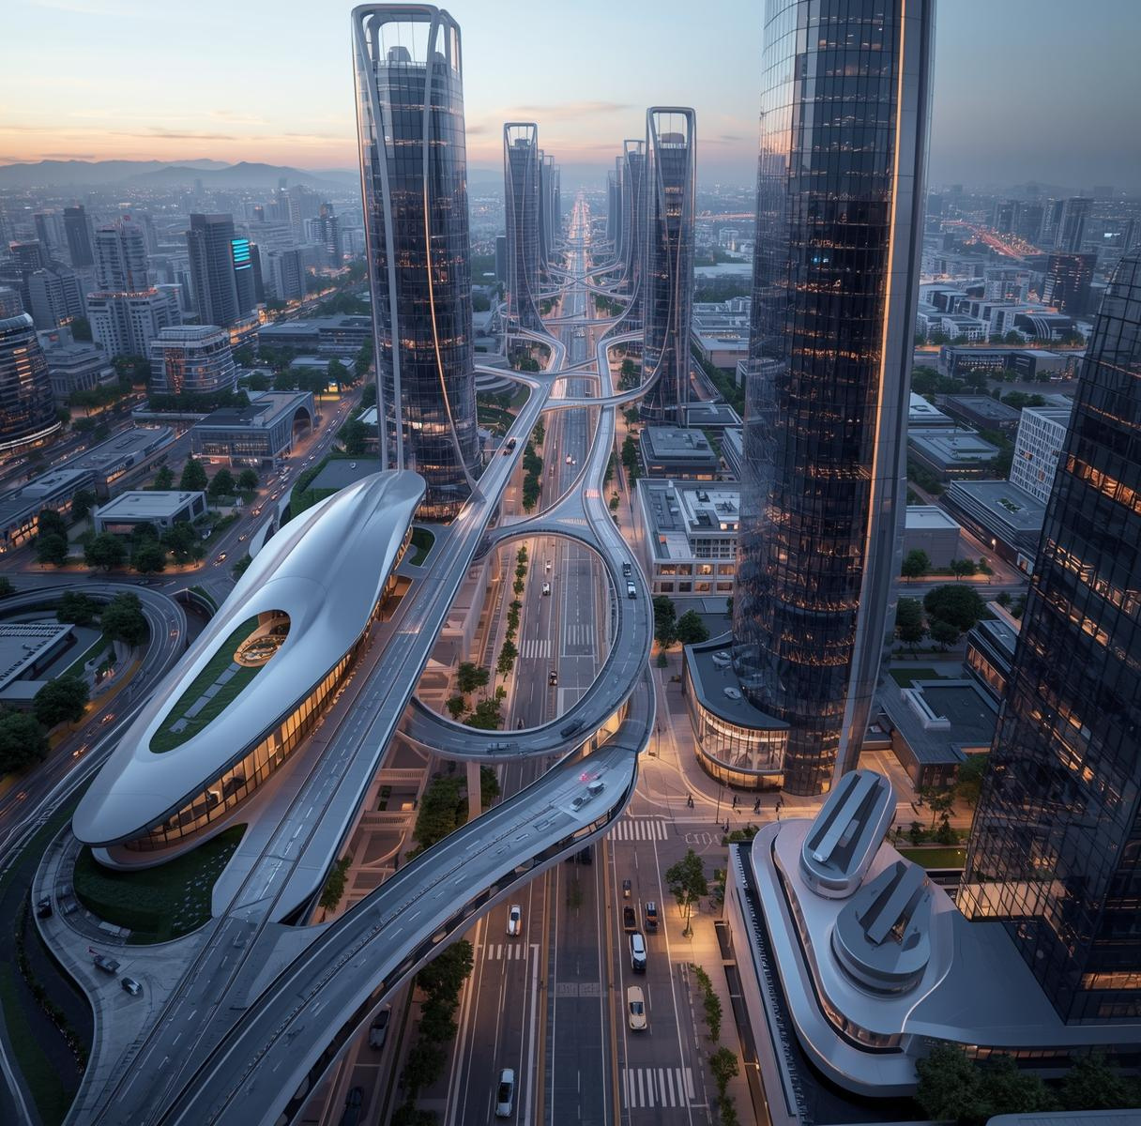
The Future
Embrace innovation and explore the technologies shaping tomorrow's world.
The proposed work can be further extended by implementing more advanced deep learning models such as transformer based super resolution methods and diffusion models to improve image reconstruction accuracy.
Future work can focus on developing lightweight and efficient models for real time satellite image processing with reduced computational cost. The system can also be improved by training on larger and more diverse satellite image datasets to enhance generalization performance.
Hybrid approaches combining multiple deep learning techniques such as convolutional neural networks and generative adversarial networks can be explored to improve image quality.
The proposed system can also be applied to other domains such as medical imaging, surveillance systems, and video resolution enhancement. Further research can focus on improving reconstruction of very small objects and reducing noise in satellite images.

Slide 11
THANKYOU

